Slide 1
Theatre 1 2nd 9 Weeks

Slide 2
Bell Ringer 10/13
Do people label you? What are those labels? Why would people assign that label to you? What could change that first impression?

Slide 3
Theatre Notes 10/12
Color Blind Casting/ Non-Traditional Casting: Color-blind casting, non-traditional casting or integrated casting is the practice of casting a role without considering the actor's ethnicity.
Casting for Type (typecasting): casting generically according to the actor's personality or physical appearance to convey an immediate message to the audience.
Director’s Notes: 1. notes written to the audience about the play, playwright or production. 2. Notes given to the actorsand crew after a rehearsal.
Pacing: The tempo of an entire theatrical performance.

Slide 4
Bell Ringer 10/14
Why do people freak out when they hear “Ok, today we are going to take a picture of you?”

Slide 5
Bell Ringer 10/15
Please do the two assignments that are in Edmodo. You should 1. submit your three head shots. 2. Read the article on discovering your “type” and write a paragraph about your types.

Slide 6
Bell Ringer 10/16
Make two lists. One list is words or images that represent the way you believe people see you. The second list is words or images that represent what people eventually discover about you as they get to know you on a deeper level.

Slide 7
Theatre Notes 10/16
Spike: Marking the rehearsal area with fluorescent masking tape to show the positions
of furniture, doors, etc.
Strike: 1. To remove something from the set 2. To take down set an props after the
show’s final performance
Principal: those playing the lead and principal supporting roles in a play
Understudy: performer in the show who studies another role and is prepared to substitute in case of emergency
Choreographer: The person responsible for designing a show’s dance numbers

Slide 8
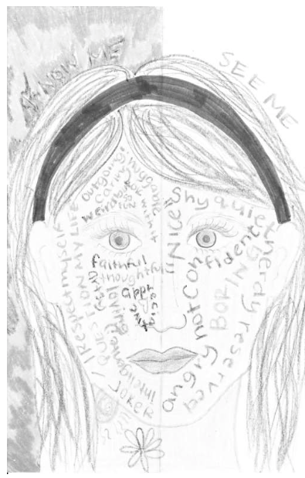
One side of the face will contain words, images, pictures, photos and objects that represent how others see you. The other side will contain words, pictures, photos and objects that represent what people discover about you as they get to know You. DUE MONDAY Beginning of Class

Slide 9
Bell Ringer 10/19
Self evaluation is difficult. Sometimes it is really hard to be honest with ourselves, or see past our own biases. What did you learn about yourself during the Artistic Headshot assignment?

Slide 10
Bell Ringer 10/21
What is the conflict in your pantomime?
How will you present the beginning, middle and end?

Slide 11
Theatre Notes 10/21
Musical Theatre: A theatrical production consisting of dialogue, music, song, dance, and story.
Production Number: elaborate song-and-dance sequences in which most of the cast takes part.
Reader’s Theatre: a form of drama in which actors are seated and read aloud from scripts.
Multi-media: using more than one medium onstage, including TV, film, dance, etc.

Slide 12
Theatre Notes 10/21
Mime: the theatrical technique of suggesting action, character, or emotion without words, using only gesture, expression, and movement.
Pantomime: the story told through mimed performance.
Mind: the element of a person that enables them to be aware of the world and their experiences, to think, and to feel; the faculty of consciousness and thought:
Body: the physical structure of a person, including the bones, flesh, and organs:
Imagination: the faculty of forming new ideas, or images or concepts not present to the senses

Slide 13
Theatre Notes 10/21
Gesture: movements of separate parts of the body such as waving an arm or shrugging a shoulder
Improvise: spontaneously invent dialogue and action
Inflection: variety of vocal pitch

Slide 14
Theatre Notes 10/21
Headshot: is a photograph used by actors and actresses in order to get them work
Resume: include the actor’s basic information including height, weight, hair color and eye color, as well as, training and experience.
Side Coaching: is the process of giving directions to actors while they are playing a scene
Masks: a special covering (representing a human face or the head of an animal or a fantastic or mythological being) with perforations for the eyes and placed over an actor’s face.

Slide 15
Theatre Notes 10/22
Batten: A long pipe or strip of wood flown from the grid from which scenery, drops, or lights are hung.
Cue: 1. The last words or action of one actor that immediately precede another actor’s speech; 2. Signal for light changes, curtain, etc.
Backdrop: In England, called the backcloth. A painted canvas or plain surface upon which light could be shown, it was flown or hung from the grid and, in combination with wings, was used to form a set on stage. Now generally replaced by the box set.
Flat: pieces of canvas stretched over wooden frames that are painted and linked together to create scenery such as walls and doorways.

Slide 16
Theatre Notes 10/22
Platform: a raised level surface on which people or things can stand.
Property: set furnishings including furniture, pictures, ornaments, or items carried or used onstage by actors.
Stage Crew: members of the technical crew who operate the curtains and scene changes.
Set: The scenery used onstage.

Slide 17
Theatre Notes 10/22
Critiquing: to evaluate a rehearsal or performance in a detailed and analytical way.
Review: a critical evaluation of a play
Comedy: A play that ends happily and arouses laughter through humorous treatment of an aspect of life.
Tragedy: A drama in which a protagonist struggles against some force, usually making an ennobling sacrifice before going down in defeat (usually death).

Slide 18
6 Week project (instead of vocabulary test)
In groups, no larger than 3 people, write a script with a beginning, middle and end that uses at least 33 of our vocabulary words. The use of the words MUST demonstrate that you understand what they mean.
The script MUST be typed and is due by the end of class Thursday.
If you wish to make up the assignment that you did not present yesterday, you may see me on Thursday morning at 8:02.
I will not accept any late work 5 school days after assignments are due.
I will not use class time to grade or make up work that you chose not to do.
Grades will be sucked out of the gradebook at 4 on Friday for progress reports.

Slide 19
Bell Ringer 12/1
Write about a personal incident that illustrates kindness. Be sure to have a beginning, middle and end.

Slide 20
Bell Ringer 12/2
Write about a personal incident that illustrates selfishness. Be sure to have a beginning, middle and end. (4 paragraphs, minimum.)

Slide 21
Final Semester Project
In groups of no more than 5, share your bell ringers about kindness and selfishness.
You will write a play (due Thursday, typed,) where the main conflict centers on kindness and selfishness.
TODAY turn in a paper for your group that 1. identifies group members, 2. a description of the main conflict and 3. an outline of the exposition, rising action, climax and resolution.
The play will be presented next week for your final exam.

Slide 22
Bell Ringer Jan 5.
What is the best New Year’s Resolution that you have ever made? Why was it the best?
What was the worst New Year’s Resolution you have ever made?
Why was it the worst?

