Slide 1
The Texas Revolution:
The Consultation of 1835
Wayne Davidson M. Ed
Da Vinci School for Science and the Arts

Slide 2
Bellwork
Define the word “consultation”*
*If you don’t know what the word means, then write down what you think it MIGHT mean.

Slide 3
Debating Independence
William H. Wharton calls a meeting to discuss future of Texas.
This Convention becomes known as the Consultation.
William Wharton

Slide 4
Debating Independence
November 4,1835: The Consultation begins.
Branch T. Archer-elected President of the Consultation of 1835.
Branch T. Archer

Slide 5
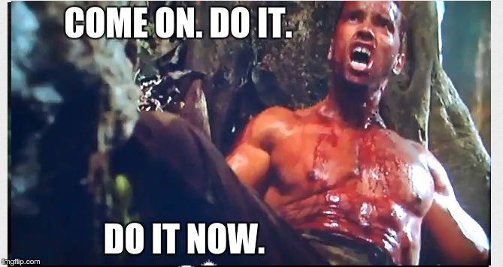
Debating Independence
Pro-War delegates want to declare independence from Mexico.

Slide 6
Debating Independence
Pro-peace delegates:
Declaring independence will alienate Tejanos
It was their desire to be loyal Mexican citizens
Goal: restoration of the Constitution of 1824

Slide 7
Debating Independence
Declaration of November 7, 1835:
Pledged loyalty to Mexico
Warned Mexico that if the Constitution of 1824 were not restored, Texas would become independent

Slide 8
Debating Independence
Provisional government created
“General Council” created to help run the provisional government

Slide 9
Debating Independence
Stephen F. Austin William Wharton Branch T. Archer
The Consultation also chose three commissioners to travel to the United States to lobby for military support.

Slide 10
Debating Independence
Sam Houston was named commander in chief of the regular army
General Sam Houston

Slide 11
Sam Houston
Born in 1793 in Virginia
Moved to Tennessee in 1807 after the death of his father.
Fond of classical literature.
Had a reputation for being a hard drinker.

Slide 12
Sam Houston
Habit of skipping school and work
1809: ran away from home and resided with Cherokee Indians.
“Colleneh”
1963 stamp issued by
the Postal Service in
honor of Houston

Slide 13
Sam Houston
1812: became a teacher
March 1813: joined army
Wounded during the Battle of Horseshoe Bend

Slide 14
Sam Houston
Became a lawyer.
Commander of the Tennessee militia.
1823: Elected to U.S. House of Representatives for Tennessee.
Sam Houston statue in Huntsville, Texas

Slide 15
Sam Houston
1827: Elected governor of TN
1829: Married & divorced Eliza Allen
Resigned as governor and went to OK to rejoin the Cherokee

Slide 16
Sam Houston
“Big Drunk”
Became a Cherokee citizen
Became a Cherokee ambassador
April 1832: Stanberry affair

Slide 17
Sam Houston
December 1832: Houston leaves for TX
Delegate to Convention of 1833
Delegate to the Consultation of 1835
Sam Houston’s Grave

Slide 18
Debating Independence
Problems:
Volunteers left under existing command and control
No power or money to pay soldiers

Slide 19
Debating Independence
Provisional government authorized the creation of a Texas navy
Protected Texas coast and ships and made raids on Mexican ships and towns
Flag of the Texas Navy

Slide 20
The Provisional Government
Some Texans wanted to attack Matamoros
Sam Houston and Gov. Smith are against attack
Attack is organized but fails to make it to Matamoros

Slide 21
The Provisional Government
Houston & William Goyens sent to negotiate a treaty of peace with the Cherokee
Cherokee agree to remain neutral.
William Goyens with
an Indian

Slide 22
The Provisional Government
Conflicts between Pro-peace delegates and Pro-war Gov. Smith
December 1935: General Council scheduled a new convention for March 1, 1836

