Slide 1
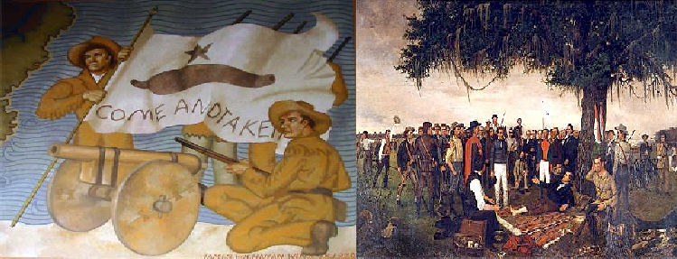
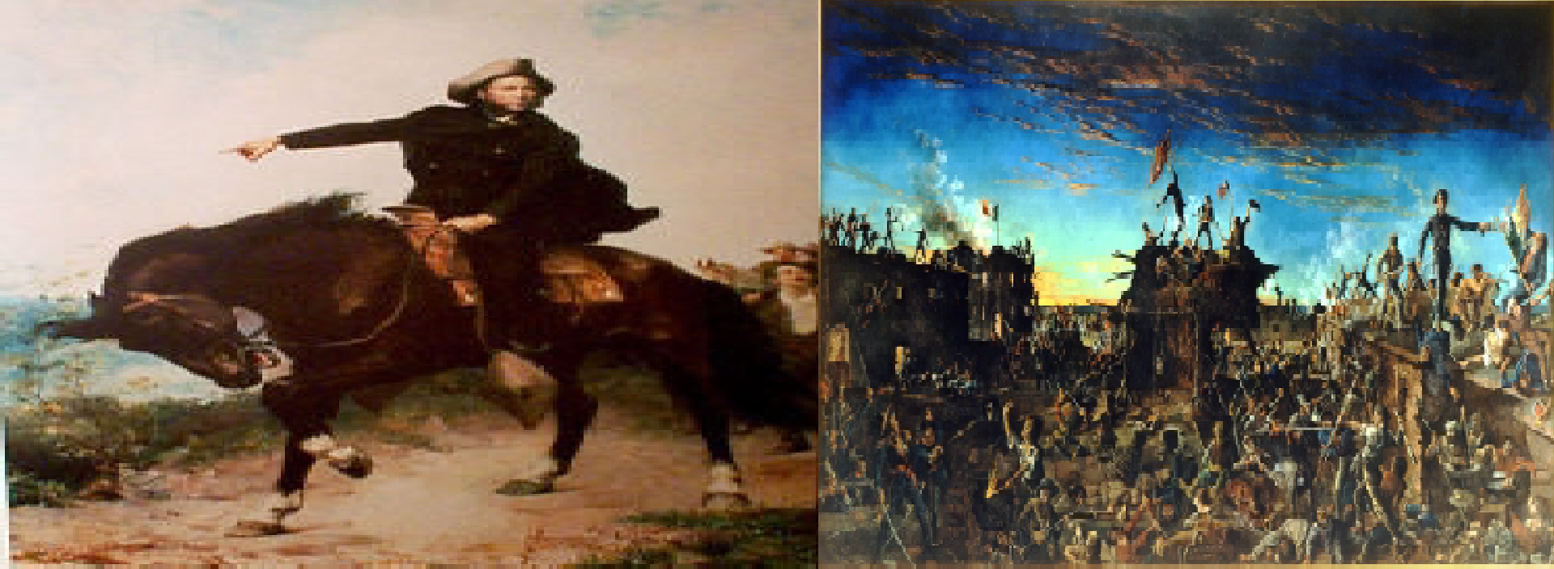
Chapter 11: The Texas Revolution Section 4: The Convention of 1836

Slide 2
Bellwork
What do you know about the U.S. Declaration of Independence and the
U.S. Constitution?

Slide 3
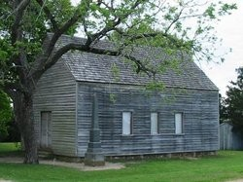
Texas Declares Independence
Delegates meet March 1, 1836 @ Washington-on- the-Brazos
Small, unfurnished building
Ankle-deep mud, cold weather
Replica of building Washington-on- the-Brazos delegates met in

Slide 4
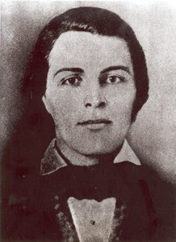
Texas Declares Independence
59 delegates
Many had experience in U.S. government
Richard Ellis named president of the convention
Richard Ellis

Slide 5
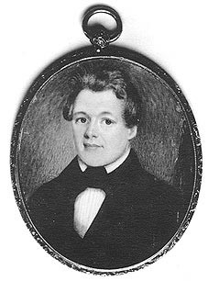
Texas Declares Independence
Vote to declare independence passed quickly
George C. Childress chaired committee
Declaration unanimously passed
George C. Childress

Slide 6
Texas Declares Independence
The document:
  Listed complaints of Texans
  Stated Texans denied rights contained in Constitution of 1824
  Declared Texas an independent country

Slide 7
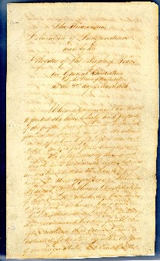
Texas Declares Independence
Presented to convention on March 2, 1863
Signed by Jose Antonio Navarro and Jose Francisco Ruiz
Page from the original Texas Declaration of
Independence

Slide 9
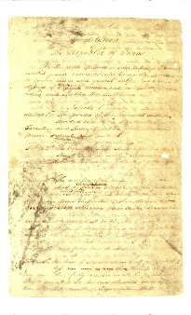
The Constitution of 1836
Constitution of 1836 modeled after the U.S. Constitution
Republican style government
Page from original Constitution of 1836

Slide 10
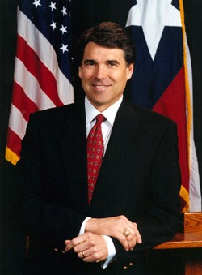
The Constitution of 1836
Executive Branch— branch of government that carries out the laws
Governor Rick Perry

Slide 11
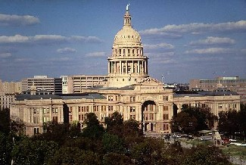
The Constitution of 1836
Legislative Branch— branch of government that makes
Texas State Capital
the laws

Slide 12
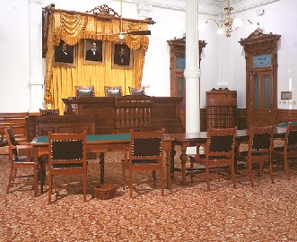
The Constitution of 1836
Judicial Branch— branch of government that decides legal cases and interprets
Original Texas Supreme Court Chamber
laws

Slide 13
The Constitution of 1836
Contents:
  Bill of Rights—statement of basic rights that the government can not take away:
    Freedom of Speech
    Freedom of Religion
    Freedom of the Press
    Trial by Jury

Slide 14
The Constitution of 1836
Contents:
  Public school system
  System of giving land to settlers
  Ensured slavery
  Free African Americans required to petition the Congress

Slide 15
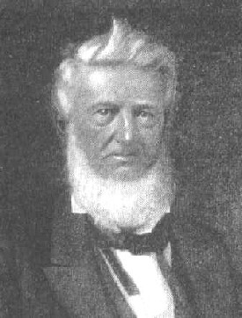
The Constitution of 1836
Established an ad interim government
David G. Burnet named the first president of an independent
Texas
David G. Burnet

