Slide 1
Bellwork
Imagine the school as passed a new rule stating that all homework had to be turned in directly to Ms. Longoria. What do you think of this rule? How would you react to this rule?

Slide 2
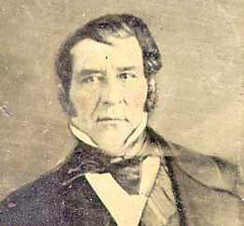
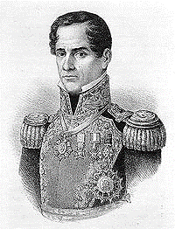
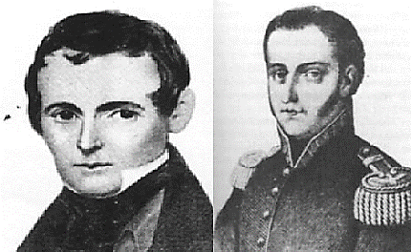
Prelude to Revolution:
Tensions Grow
Wayne Davidson M. Ed.
Da Vinci School for Science and the Arts

Slide 3
Conflicts at Anahuac
Mexico places troops in Texas to enforce the Law of April 6, 1830.
Conflict ensues between the settlers and soldiers.

Slide 4
Conflicts at Anahuac
Fall 1830: Troops establish a fort at the mouth of the Trinity River on Galveston Bay.
Anahuac: Important immigration point and trade route

Slide 5
Conflicts at Anahuac
Col. Juan Davis Bradburn commanded troops at fort.
Francisco Madero, a surveyor, was approving land titles for settlers in the area.
February 1831: Madero is arrested by Bradburn.

Slide 6
Conflicts at Anahuac
Settlers are very angry.
Bradburn dissolves the town government of Liberty and “borrows” the slaves of residents to complete construction on the fort.

Slide 7
Conflicts at Anahuac
George Fisher: U.S. settler and Mexican customs official
Issues rule that all ships landing in Texas pay their customs duties at Anahuac

Slide 8
Conflicts at Anahuac
Some ship captains ignored Fisher's rule
Bradburn sent out soldiers to enforce the law, some shots were fired, and one soldier wounded
Austin: Said the act was not one of disloyalty, but a problem with Fisher

Slide 9
Conflicts at Anahuac
Texians were unpleased with the performance of George Fisher as a customs collector.
Bradburn arrests several citizens, including two attorneys William Barret Travis & Patrick Jack , which further enraged Texians.

Slide 10
The Turtle Bayou Resolutions
William Jack, brother of Patrick Jack, rallies townspeople
Townspeople demand release of prisoners
John Austin organizes a force of 150 men and marches towards Anahuac.

Slide 11
The Turtle Bayou Resolutions
Gunfire exchanged
Bradburn agrees to release prisoners if settlers withdraw
Bradburn does not keep promise

Slide 12
The Turtle Bayou Resolutions
Settlers withdraw to Turtle Bayou
John Austin goes to Brazoria to get a cannon
While they wait for John Austin to return with the cannon, the residents drew up several resolutions
Resolution-statements of the opinion of a group

Slide 13
The Turtle Bayou Resolutions
The colonists declared that the event was not a rebellion against Mexico
Citizens were simply defending their rights as given under the Constitution of 1824
Supported General Antonio López de Santa Anna, who was trying to overthrow President Anastacio Bustamante

Slide 14
The Turtle Bayou Resolutions
Bustamante had taken complete control of the government as a dictator
Most Texans supported Santa Anna in his struggle with Bustamante

Slide 15
The Battle of Velasco
Mexican forces under the command of Col. José de las Piedras arrive from Nacogdoches.
Piedras blames Bradburn for the outbreak
Bradburn removed from his post and prisoners released

Slide 16
The Battle of Velasco
John Austin returns with the cannon.
Unaware of what has happened.
June 6, 1832: At Velasco, Mexican troops refuse to let Austin and company pass.
Fighting breaks out.

Slide 17
The Battle of Velasco
Texans defeat the Mexican forces.
Arrived in Anahuac triumphantly only to find the conflict settled.
The Battle of Velasco could be called a mistake, which would lead to an increase in tensions.

Slide 18
What next??
Mexican authority continued to grow stronger
Texans hoped that Santa Anna would be successful in ousting Bustamante

