Slide 1
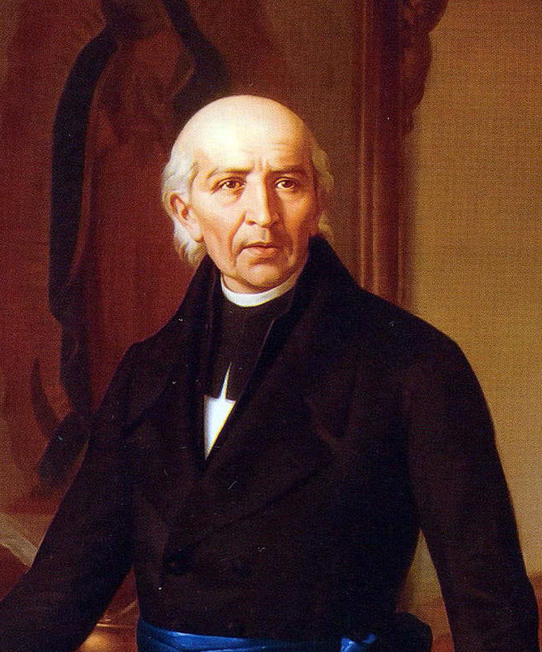
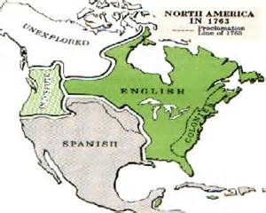
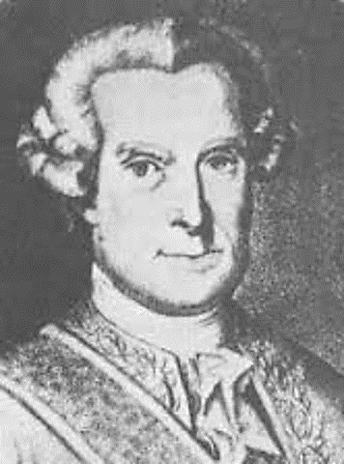
Conflicts of Empire:
Changes in Spanish Texas
Wayne Davidson M.Ed
Da Vinci School for Science and the Arts

Slide 2
The MarquÉs de Rubí Report
1754: France and England go to war over control of the Ohio Valley.

Slide 3
The MarquÉs de Rubí Report
The war spreads to Europe
Spain sides with France
Britain Defeats France

Slide 4
The MarquÉs de Rubí Report
The treaty of Paris is signed after the war.
Cede- to officially give up a territory from one nation to another.

Slide 5
The MarquÉs de Rubí Report
The Treaty of Paris
France Gives up Canada and all land east of the Mississippi River.
Spain gives up Florida
The agreement gives Louisiana to Spain.
As a result, the French are no longer a threat to Texas.

Slide 7
North America after the Treaty of Paris

Slide 8
The MarquÉs de Rubí Report
In 1766, The MarquÉs de Rubí begins an inspection of the Northern borderlands.
He Becomes very concerned when inspecting Northern Presidios

Slide 9
The MarquÉs de Rubí Report
He found better conditions at San Antonio and La Bahía.
He also noted that efforts to convert and befriend the Indians had failed.
Rubí noted that one of the reasons that Spanish America’s borderlands were being threatened in the 1760s was because Spain did not have the manpower, military might, or wealth to be able to hold its land there.

Slide 10
The MarquÉs de Rubí Report
Recommendations:
Spain pull back to the “real” Frontier.
Build a string of forts from California to texas.
Only San Antonio and Santa Fe would remain above this line.
Abandon The East Texas settlements.
Page from the Marqués de Rubí’s diary.

Slide 11
The MarquÉs de Rubí Report
Recommendations for Texas:
Abandon all missions and presidios except those at La Bahía and San Antonio.
San Antonio should replace Los Adaes as the capital of Spanish Texas.

Slide 12
The MarquÉs de Rubí Report
Recommendations for Texas (Continued):
Spanish population in East Texas should be moved to San Antonio to strengthen defense of the settlement and mission there.
Befriend the Comanche and use them to help in fighting the Apache.

Slide 13
Changes in Texas Policies
In 1773, the Spanish begin the withdrawal from East Texas.
Tejanos-persons of Spanish descent who lived in Texas

Slide 14
Changes in Texas Policies
People did not want to leave.
Los Adaes replaces San Antonio as The capital of Spanish Texas.
Best farmland is already taken
People become homesick and ask to return home

Slide 15
Changes in Texas Policies
Allowed to return as far east as the Trinity River.
1774: Antonio Gil Ybarbo-led a group to present-day Madison County where they founded Bucareli.

Slide 16
Changes in Texas Policies
Bucareli is plagued by Comanche raids, disease, and flooding
Antonio Gil Ybarbo leads settlers further east.

Slide 17
Changes in Texas Policies
Antonio Gil Ybarbo founded the town of Nacogdoches, which became a gateway between Texas and Louisiana.
Statue of Antonio Gil Ybarbo in present-day Nacogdoches

Slide 18
Changes in Texas Policies
1785: The Spanish sign a peace treaty with the Comanche Indians
Treaty maintained peace for some 30 years

