Slide 1
Conflicts of Empire :
Spanish Rule Ends in Mexico
Wayne Davidson M. Ed
Da Vinci School for Science and the Arts

Slide 2
Bellwork
Describe some of the efforts made to make Mexico/Texas independent of
Spain

Slide 3
Mexico Wins Independence
José María Morelos y Pavón will lead fight for Mexican independence after the death of Father Hidalgo.
1820: Captured & killed
José María Morelos y Pavón

Slide 4
Mexico Wins Independence
1820: Political changes in Spain weakened the government
Rebellion is relaunched
Military officer Agustín de Iturbide & rebels led by Vicente Guerrero join forces

Slide 5
Mexico Wins Independence
1821: The Spanish forces in Mexico are defeated. Independence is won!!!

Slide 6
Mexico Wins Independence
Agustín de Iturbide:
Declares himself the first ruler, Emperor of an independent Mexico.
Agustín de Iturbide

Slide 7
Mexico Wins Independence
Iturbide proved to be an unpopular leader
Forced from power
Mexico declared a Republic

Slide 8
Tejano Ranchers
Several thousand people lived around the lower Rio Grande.
Lush grasslands turned the Rio Grande into a major ranching area.

Slide 9
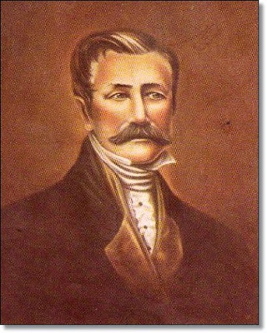
Tejano Ranchers
Martín de León- Successful rancher and early Texas trail driver.
Martín de León

Slide 10
Tejano Ranchers
Wealthy Tejanos lived in houses that resembled forts
Others lived in jacales- small one room huts made of sticks and mud

Slide 11
Mexican Policies in Texas
Spain had begun to secularize the missions.
Secularize-the process of moving from religious to civil control.

Slide 12
Mexican Policies in Texas
San Antonio de Valero: First mission to be secularized
1821-1825: Housed the Flying company of San José y Santiago del Alamo de Parras.

Slide 13
Mexican Policies in Texas
Mexico continued the process of secularizing missions
1832: All mission secularized
Mission lands and buildings placed under local control

Slide 14
Mexican Policies in Texas
Mexico had to develop a new policy for settling and governing Texas.
Texas population too small-offered free land.
Spain had opened Texas to U.S. immigration-Mexico would have to decide whether or not to continue this policy.

