Slide 1
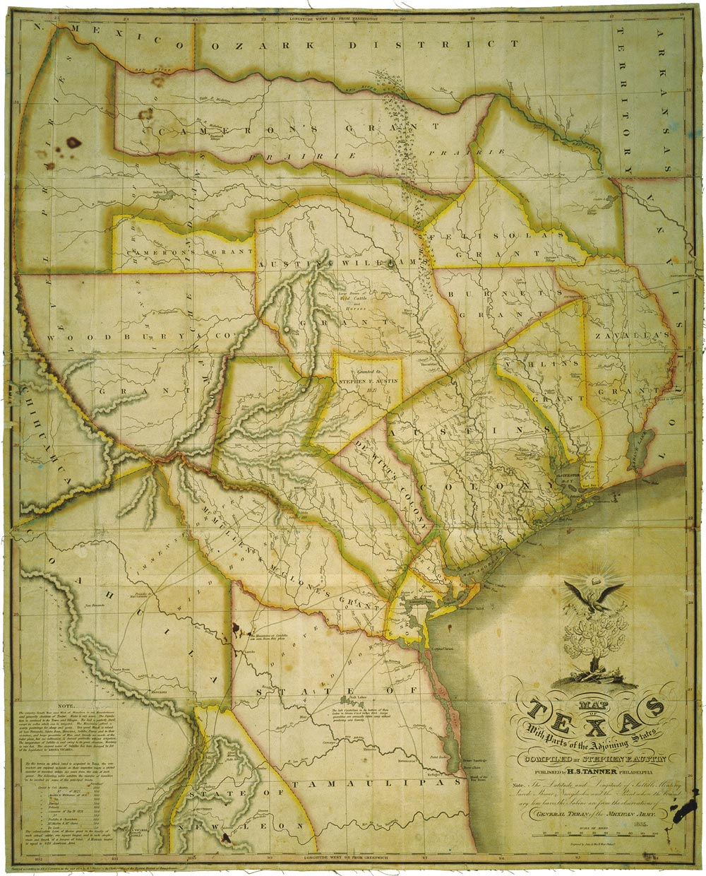
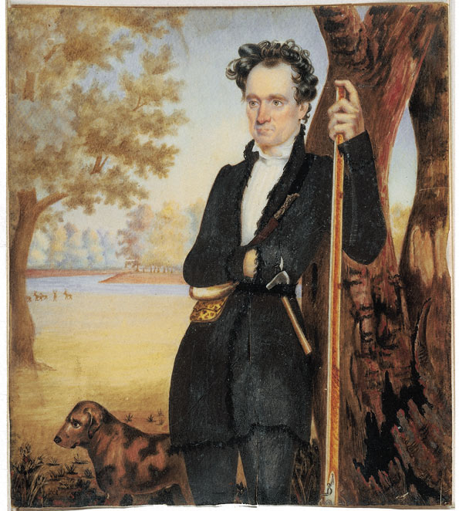
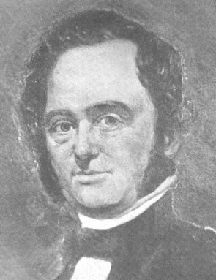
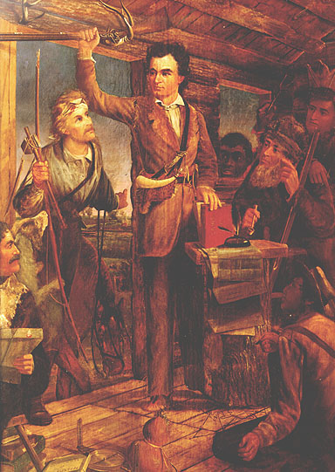
Americans Settle in Texas:
The Austin Colonies
Wayne Davidson M.Ed
Da Vinci School for Science and the Arts

Slide 2
Early Problems in Austin’s Colony
August 1823: Austin returns from Mexico
Settlers discouraged
A giant statue of Stephen F. Austin was started in April of 2004 to establish a tribute to the father of Texas, Stephen F. Austin. The location is the north side of Highway 288 about a mile south of Highway 35.

Slide 3
Early Problems in Austin’s Colony
Drought had ruined crops
Settlers resorted to eating wild game
They were suffering many Indian attacks

Slide 4
Early Problems in Austin’s Colony
Established a headquarters near present-day La Grange
Established militias to defend against Indian attacks

Slide 5
The Old Three Hundred
Fall 1824: 297 families and single men had received lands in colony
Called the “Old Three Hundred”
Austin’s grave marker at the Texas State Cemetery

Slide 6
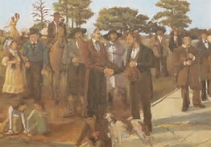
The Old Three Hundred
The Old Three Hundred- Settlers in Stephen F.Austin’s first colony.

Slide 7
The Old Three Hundred
Demographics:
Came mostly from the southern U.S.
Mostly farmers
Many slaveholders
Well-educated
Law-abiding

Slide 8
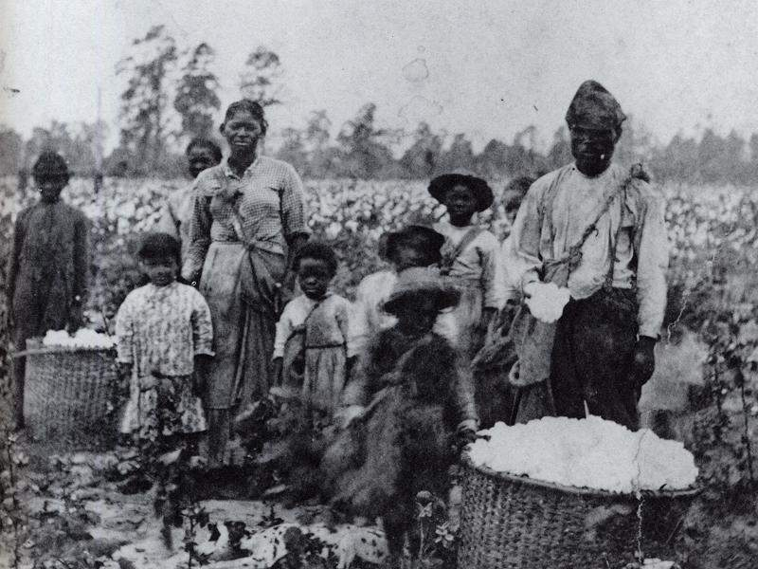
The Old Three Hundred
By 1825, Austin’s colony had over 1,790 people living there.
Of that number, more than 400 were slaves.

Slide 9
The Old Three Hundred
Jane Long: One of the Old Three Hundred. She became a successful female plantation owner, slaveowner, and ran a boarding house in San Felipe.

Slide 10
San Felipe de Austin
Replica of the home of Stephen F. Austin
San Felipe, TX
San Felipe de Austin:Capital of Austin’s first colony.

Slide 11
Austin’s Other Colonies
Between 1825-1831 Austin acquired contracts for four more colonies
All overlapped his first except one.
It would become known as Austin’s “Little Colony”.
Stephen F. Austin

Slide 12
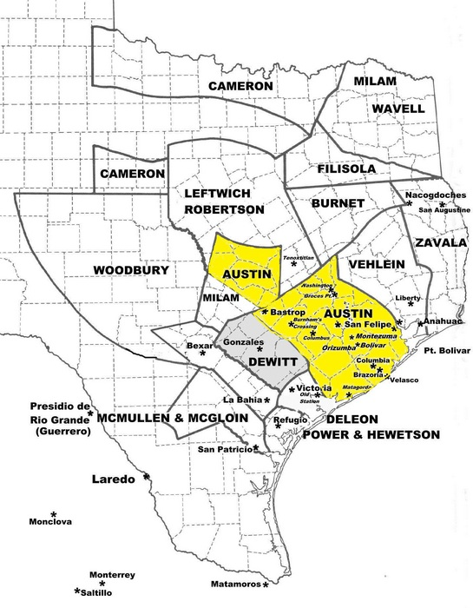
The Little Colony
Provided settlement for 100 families
Suffered frequent Indian attacks
Bastrop: Capital of Austin’s Little Colony

