Slide 1
Culture
The 7 Elements of Culture

Slide 2

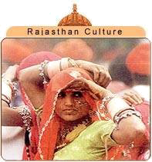
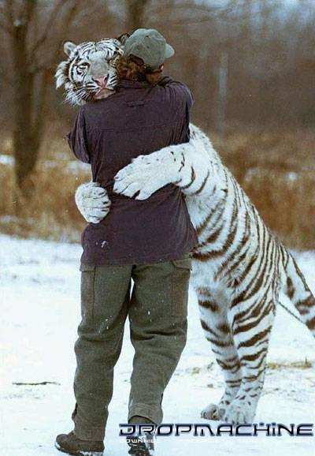
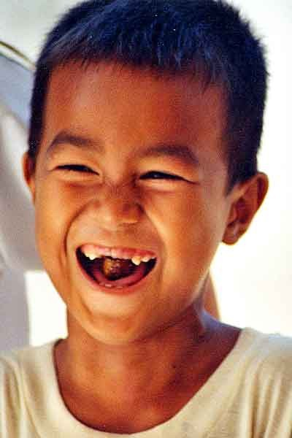
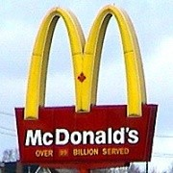
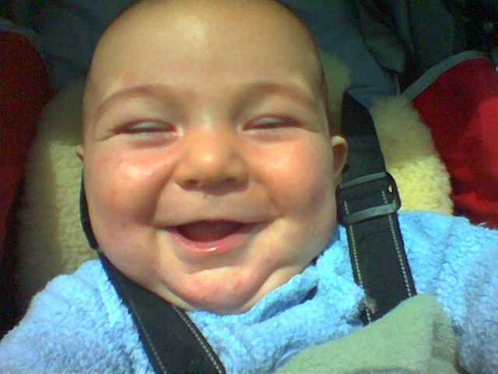
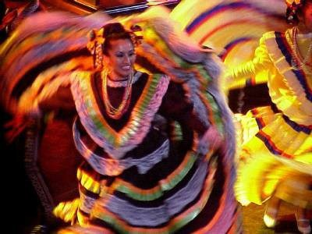
Culture
Culture: everything that makes up a person’s entire way of life

Slide 3
7 Elements of Culture
These are things that all cultures have in common.
What might some of those things be?
1. Social Organization
-When a culture organize its members into smaller groups
◻
What might some smaller groups be in a culture?
▪
▪
▪
▪
Families Friends
Religious groups Social classes
▪
▪
Occupation Interest groups

Slide 4

7 Elements of Culture
1. Social Organization, cont.
- family: the most important unit of social organization
▪
▪
Nuclear family- husband, wife, children Extended family- several generations in one household
- respect for elders is usually strong in extended fams.

Slide 5
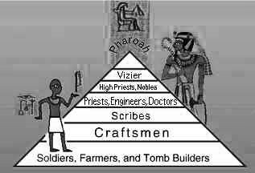
7 Elements of Culture
1. Social Organization, cont.
- social classes: a way to rank people in order of status
■
What can social class be based on?
◻
◻
◻
◻
Money Occupation Education Race
Etc.
◻

Slide 6
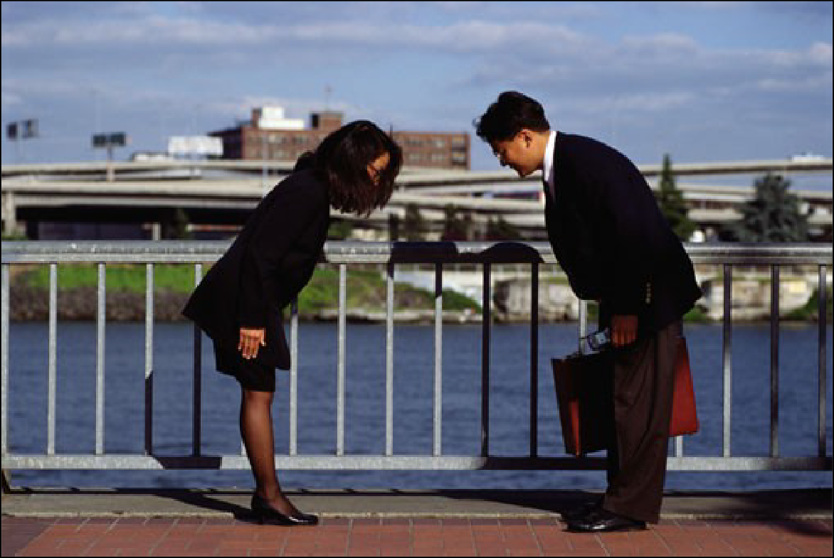

7 Elements of Culture
2. Customs and Traditions
- rules of behavior (written and unwritten)

Slide 7












7 Elements of Culture
1. Language
■
Important for communication and passing on traditions and beliefs
There is some debate about making English the official language of the United States.

Slide 8




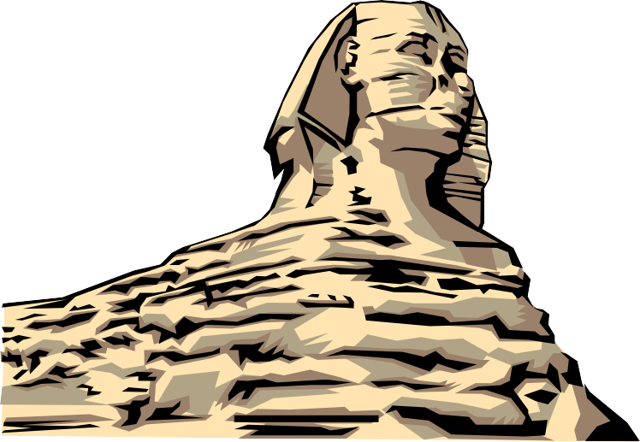
7 Elements of Culture
Arts and Literature
  teach about a culture’s values
  promote cultural pride and unity

Slide 9
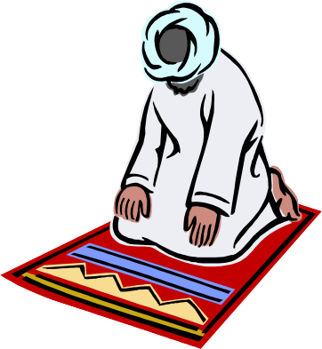
7 Elements of Culture
1. Religion
■
Monotheism: belief in one god Polytheism: belief in more than one god
■
◻
Major World Religions
■
Judaism, Christianity, Islam, Hinduism, Buddhism

Slide 10
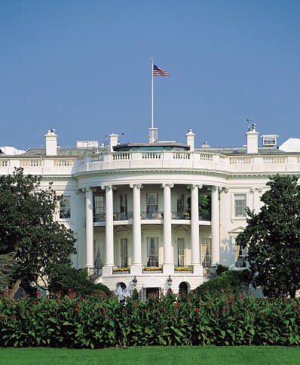
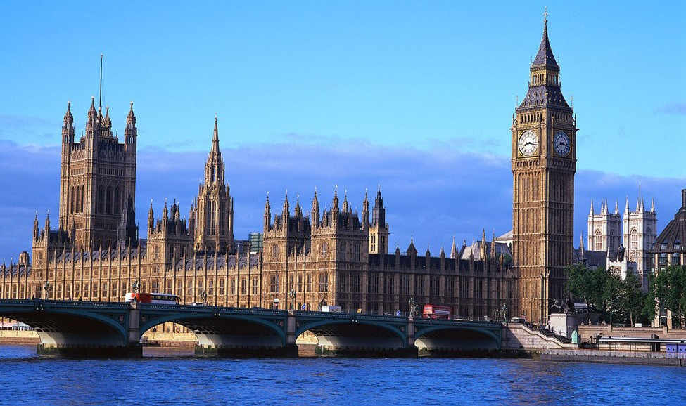
7 Elements of Culture
6. Forms of Government
■
People form governments to provide for their common needs
Types
■
◻
Democracy: people have supreme power Republic: people choose leaders to represent them Dictatorship: a ruler or group holds power by force
◻
◻
White House
Great Britain’s Houses of Parliament

Slide 11
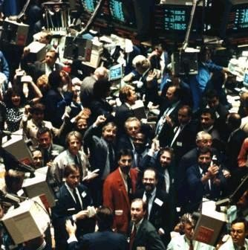
7 Elements of Culture
1. Economic Systems
■
Four types
Traditional: people produce most of what they need to survive
Market: basic economic questions are answered by buying/selling goods and services
Command: government controls answers to economic questions
Mixed: individuals make some economic decisions, the government makes others

Slide 12
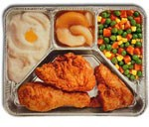

Ways Cultures Change
1. Technology
◻
Cars, telephone, computers, TV dinners
2. Environment Changes
4. New Ideas (like recycling)
4. Diffusion: movement of customs and ideas from one place to another

Slide 13
Be Careful of…
Ethnocentrism: judging other cultures by the standards of your own
  Assuming your own culture to be the best
Racism: belief that one racial group is naturally superior to another
  Race is a culture thing. It does not actually, physically exist.

